Slide 1
TRAFFIC MANAGEMENT

Slide 2
GROUP MEMBERS
HARIHARASUDHAN B
ARUN U.S
DHAKSNAMOORTHI M
KABILAN C
ASHWIN G

Slide 3
INTRODUCTION
"In today's urban landscape, the Internet of Things (IoT) is revolutionizing public transport. This interconnected network of smart devices, sensors, and data analytics optimizes efficiency, enhances passenger experiences, and addresses longstanding challenges. IoT is driving the future of urban mobility, reshaping how we move within our cities."

Slide 4
PROJECT DEFINITION
1. Objective Definition:
Clearly outline project goals and objectives, emphasizing improved efficiency and the quality of public transportation services.
2. IoT Sensor System Design:
Design a robust IoT sensor system, specifying the types of sensors required, data collection methods, and data transmission protocols.

Slide 5
PROJECT OBJECTIVES
The project aims to enhance public transportation by delivering real-time information to passengers, predicting vehicle arrival times, monitoring ridership levels, and ultimately improving the quality of service. This will be achieved through the integration of IoT sensors and Python technology, ensuring efficient and reliable public transit.

Slide 6
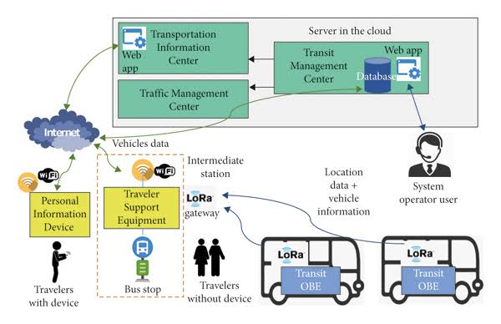

Slide 7
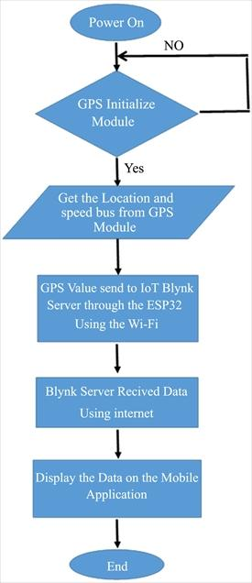
PROJECT OBJECTIVES
This project seeks to elevate public transportation by employing IoT sensors and Python technology. It endeavors to furnish real-time transit data, forecast vehicle arrival times, and observe ridership trends.

Slide 8
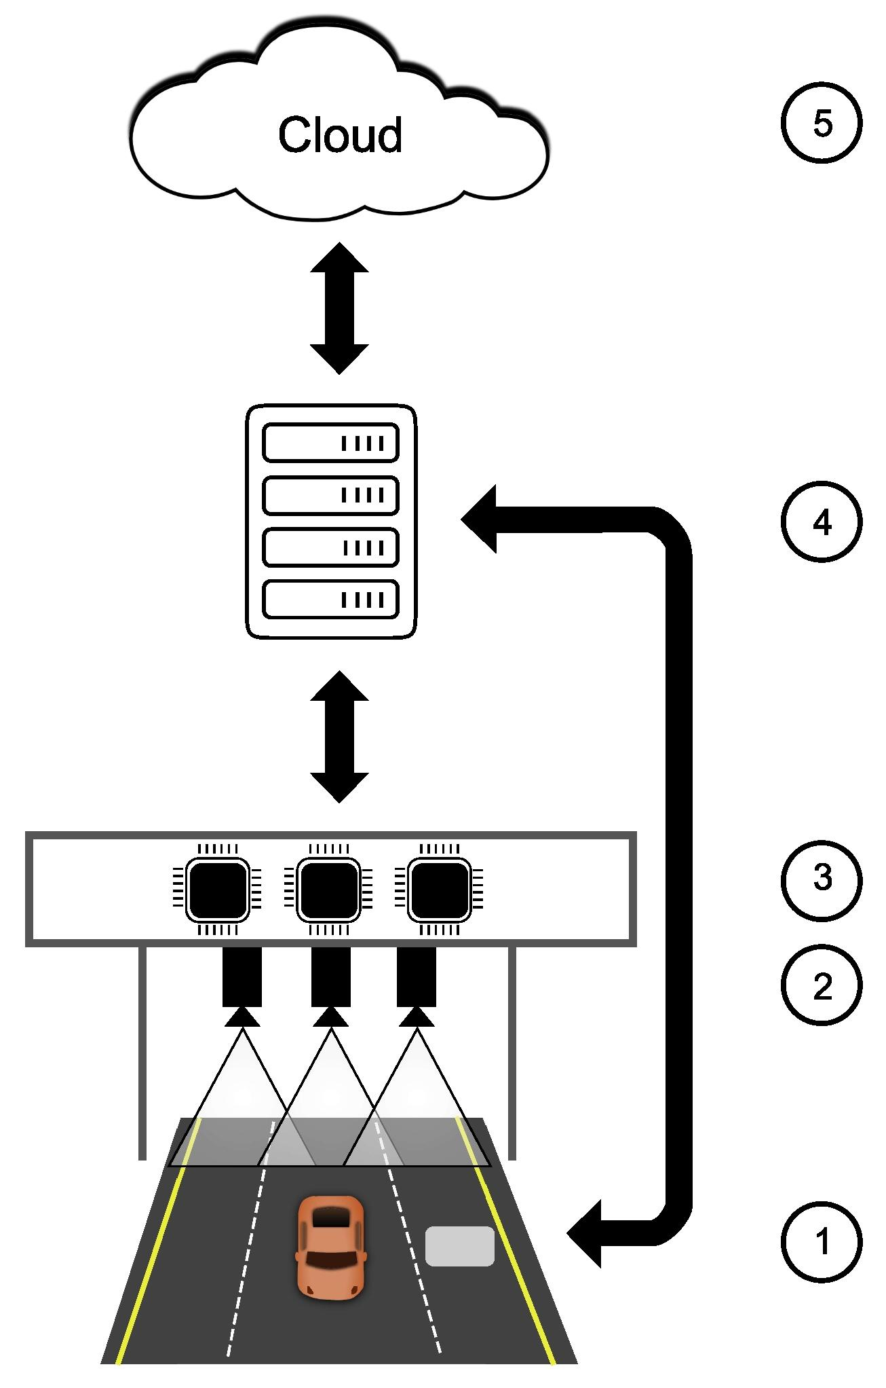
IOT SENSOR DESIGN

Slide 9
IOT SENSOR DESIGN
For the IoT sensor design, we'll carefully select sensors like GPS and passenger counters, determine their optimal placement, plan data transmission and power supply, set up data storage, calibration, and redundancy measures. This thoughtful design ensures accurate data collection and integration into the transit information platform.

Slide 10
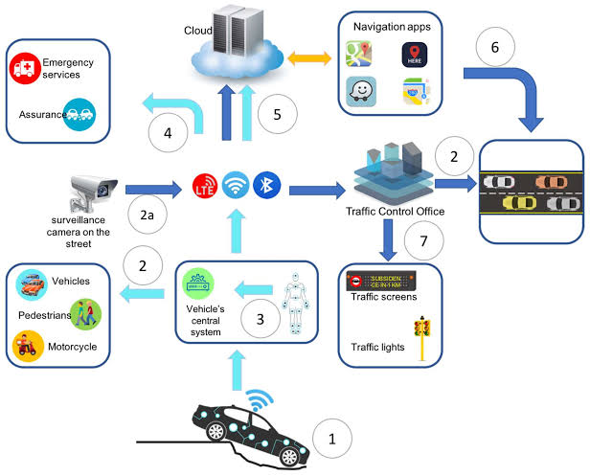

Slide 11
IOT SENSOR DESIGN
In the IoT sensor design phase, we’ll meticulously select and deploy sensors such as GPS for location tracking and passenger counters to monitor occupancy within public transportation vehicles. Strategic sensor placement will be determined to ensure precise data collection. We’ll establish robust data transmission mechanisms, considering communication protocols and reliability. A reliable power supply, whether through batteries or vehicle power integration, will be secured to sustain sensor operations. Data storage solutions will be implemented, addressing storage capacity and data retention requirements. Calibration and maintenance protocols will be established for data accuracy.

Slide 12
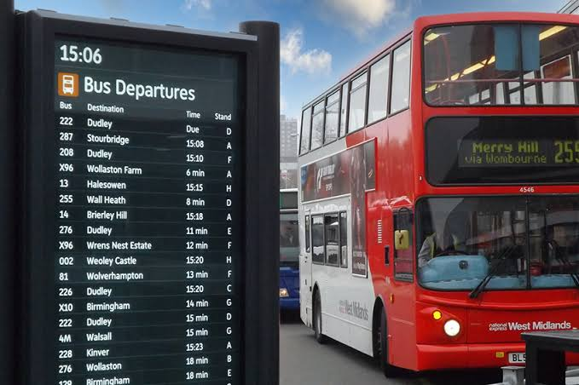
REAL TIME TRANSIT INFORMATION PLATFORM

Slide 13
REAL TIME TRANSIT INFORMATION PLATFORM
Design a user-friendly web-based platform for real-time transit information. Features include data integration with IoT sensors, interactive maps, predictive arrival times, mobile accessibility, user authentication, data visualization, alerts, accessibility compliance, security, scalability, and a feedback mechanism. Enhance passenger experience and encourage public transportation usage.

Slide 14
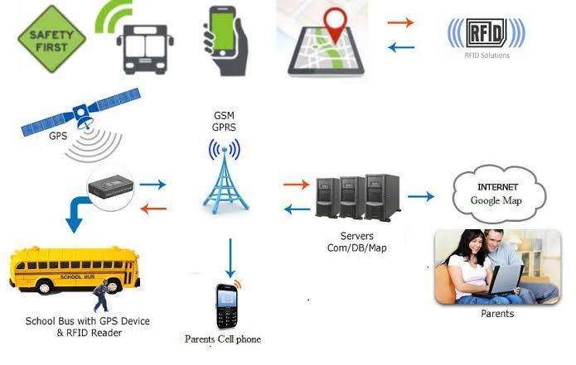

Slide 15
INTEGRATION APPROACH
Integrate IoT sensors with the platform via defined data protocols and APIs, ensuring secure and efficient data transmission. Implement data parsing, validation, and aggregation for real-time updates. Transform raw data into useful information, handle errors, store data securely, and plan for scalability while rigorously testing the integration for accuracy and responsiveness.

Slide 16
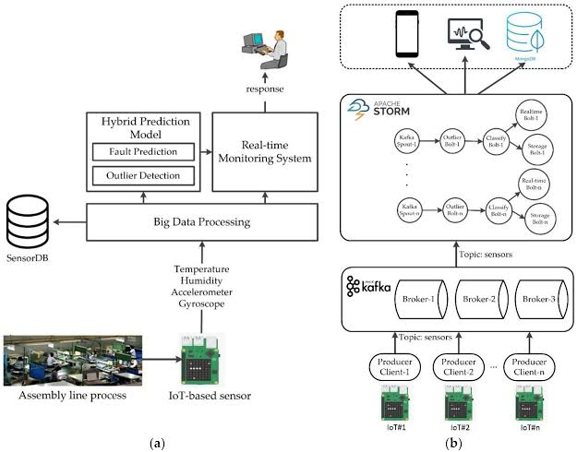

Slide 17
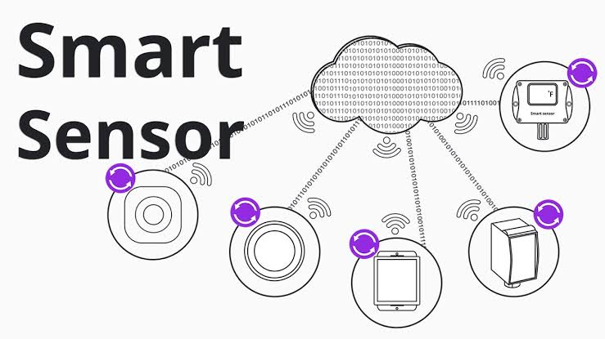
INTEGRATION APPROACH
The integration approach will establish a robust connection between IoT sensors and the platform. This involves data transmission through designated protocols and APIs, thorough data processing, and error handling for reliability. The scalable design will accommodate future sensor expansions while rigorous testing ensures data accuracy and platform

Slide 18
CONCLUSION
In conclusion, leveraging IoT technology for public transport optimization holds immense promise. By integrating sensors, predictive algorithms, and real-time information platforms, we can enhance passenger experiences, reduce wait times, and improve the efficiency and sustainability of public transportation systems. This innovation has the potential to transform urban mobility, making it more convenient and environmentally friendly for all. However, it's essential to address data security, privacy, and infrastructure challenges to realize the full potential of IoT in public transport optimization.

Slide 19


